Slide 1

QUIBERON RACE PREVIEW
Elite Analysis · June 2026
USA Triathlon High Performance

Slide 2
Race Week Schedule
Quiberon
June 18 – 21, 2026 • Espace Louison Bobet, Bd René Cassin, Quiberon (CEST, UTC+2)
Friday • June 19
Saturday • June 20
Sunday • June 21
Familiarization & Briefing
WTCS SPRINT RACE DAY
Mixed Relay Day
07:00 – 10:00 | Pool training — Neptune Swimming Pool
09:00 – 09:30 | Bike familiarization — 2 laps from transition (escorted)
10:30 | Swim familiarization — beach
14:00 – 17:00 | Pool training — Neptune
16:00 – 16:30 | ★ Mandatory Elite Athletes' briefing — Espace Louison Bobet
16:30 – 17:00 | Elite team medical meeting — LOC Office
Post-briefing | Race package distribution
19:00 | Run course measurement (coaches) — Finish Area, Bd René Cassin
08:30 – 09:30 | WTCS Men — Athletes' lounge check-in
09:00 – 09:45 | WTCS Men — Transition + swim warm-up
09:50 | WTCS Men — Athletes' introduction
10:00 | ★ WTCS MEN START
11:05 | WTCS Men medals ceremony
10:30 – 11:30 | WTCS Women — Athletes' lounge check-in
11:00 – 11:45 | WTCS Women — Transition + swim warm-up
11:50 | WTCS Women — Athletes' introduction
12:00 | ★ WTCS WOMEN START
13:10 | WTCS Women medals ceremony
13:30 – 14:00 | Mixed Relay — Team Declaration
20:00 – 20:30 | Mixed Relay — Team Managers' Meeting (Elite Athletes Area)
07:00 – 10:00 | Pool training — Neptune
12:30 – 12:45 | Mixed Relay — Final Team Declaration
15:30 – 16:30 | Mixed Relay — Athletes' lounge check-in
16:00 – 16:45 | Mixed Relay — Transition + swim warm-up
16:50 | Mixed Relay — Athletes' introduction
17:00 | ★ MIXED RELAY START
18:30 | Mixed Relay medals ceremony
Times local to Huatulco (CST, UTC-6). Schedule confirmed from World Triathlon race-info page; subject to organiser updates.

Slide 3
Key Course Differentiators
Quiberon
QUIBERON
COURSE AT A GLANCE
Set on the southern tip of Brittany’s Quiberon peninsula, this will be the first edition of WTCS Quiberon. Expect a cool-water, likely wetsuit sprint race with a decently long beach start. The bike is largely flat but has multiple sections along the coast with potential for exposure to coastal winds. The run is also a simply out and back on asphalt that should lead to fast splits.
Swim:
750 m – 1 lap
Bike:
22km – 4 laps x 5.5km
Run:
5km – 2 laps x 2.5km
Format:
Sprint Triathlon
COURSE FEATURES
Bike Laps:
4
Run Laps:
2
• Beach Start 750m Atlantic Swim. Cool water, likely wetsuit-legal.
QUICK LINKS
• Flat Bike course. 4 laps of 5.5km will make the distance longer than normal. No real elevation but potential for exposed wind could come into play.
Current Race Info:
Race Info | 2026 World Triathlon Championship Series Quiberon
• Mostly asphalt out and back run. Simple 2 lap course.
• First race at this venue.

Slide 4
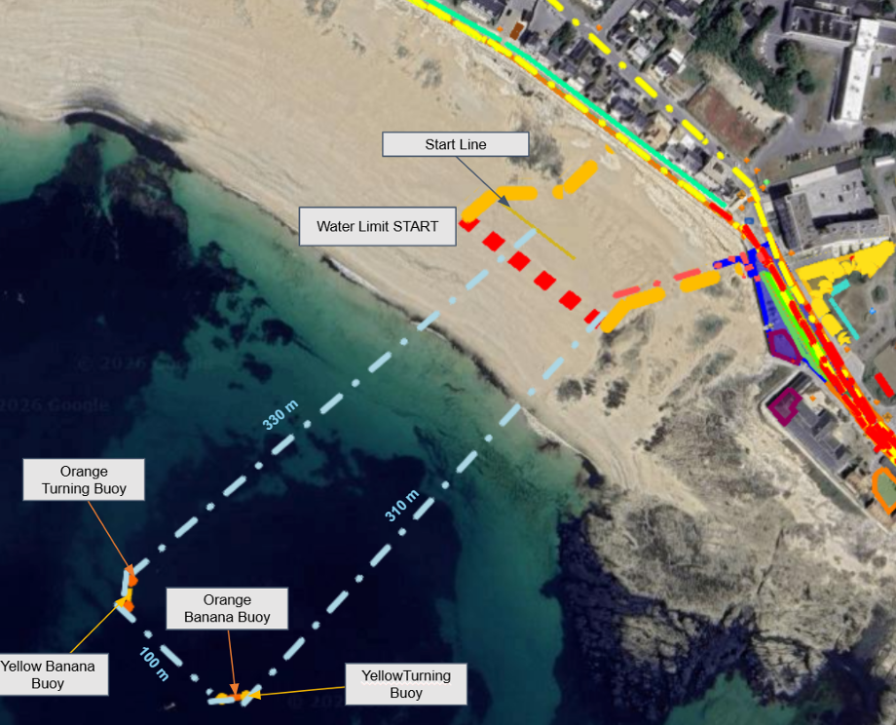
Swim Course Profile
Quiberon
750 m • single lap
Open ocean — Atlantic / Bay of Quiberon
Distance
Layout
Start
750 m
Atlantic Ocean
Beach start
[Drop swim course map here] Save the organiser map as: ppt files/support/quiberon_swim_course.png It will be embedded automatically on the next run.
Water Temp
Wetsuit
Lap Count
18.0 °C (7-yr avg)
Wetsuit Likely
1
Tactical Notes
• Single 750 m loop. Historically cold water that will make for a wetsuit legal race
• Beach start running entry into the first 330m segment to the turning buoy
Source: World Triathlon Elite Athlete Guide — WTCS Quiberon, 20 Jun 2026
• Atlantic exposure brings chop and swell — sighting on bigger surface waves than typical WTCS venues
• Two left hands turns comprise simple box style course

Slide 5
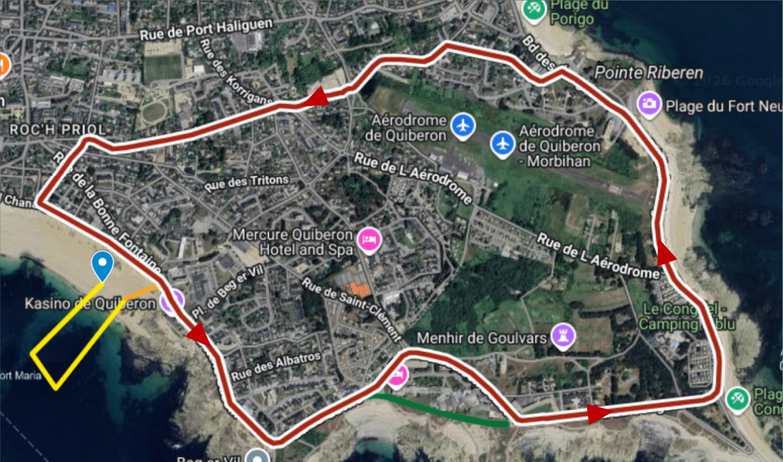
Bike Course Profile
Quiberon
22 km • 4 × 5.5 km loops
Closed coastal/urban circuit — Boulevard René Cassin, Quiberon Peninsula
[Drop course map here] Save the organiser course map as: ppt files/support/quiberon_bike_course.png It will be embedded automatically on the next run.
Elevation / Lap
Total Climb
Avg Grade
—
—
—
Max Climb Grade
Wind
Loops
—
Coastal Wind Likely (~20km)
4 × 5 km
Tactical Implications
• Generally flat profile with no significant climbs. Single loop with limited technical sections
Source: World Triathlon Elite Athlete Guide — WTCS Quiberon, 20 Jun 2026
• Coastal sections exposed to Atlantic wind.
• Two wheel stations: René Cassin Street (just out of T1) and Fort Neuf Street / Parking Nautique near Pointe Riberen
• Slightly longer course than standard, 22km total

Slide 6
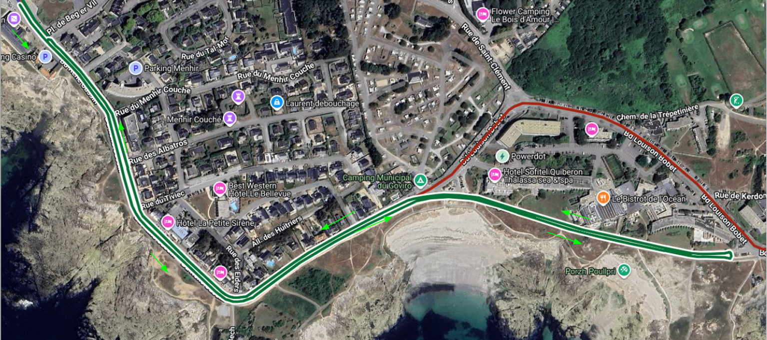
Run Course Profile
Quiberon
5.0 km • 2 × 2.5 km
Asphalt out-and-back; small stabilized (gravel) section per lap
Distance
Lap Structure
Total Climb
5.0 km
2 × 2.5 km
—
[Drop run course map here] Save the organiser map as: ppt files/support/quiberon_run_course.png It will be embedded automatically on the next run.
Avg Grade
Max ▲ / ▼
Heat Risk
—
—
LOW
Tactical Notes
• Flat out-and-back asphalt course with one short stabilized-surface section per lap
• Aid stations at 0.2 km (just after T2) and 1.25 km. Pass each twice across the 2 laps
Source: World Triathlon Elite Athlete Guide — WTCS Quiberon, 20 Jun 2026
• Penalty Box located on the left, ~50 m before the Transition Area.
• Cool Atlantic conditions; June daily high ~23 °C, low ~13 °C means little heat-stress concern
• Lap structure: 2 × 2.5 km out-and-back

Slide 7
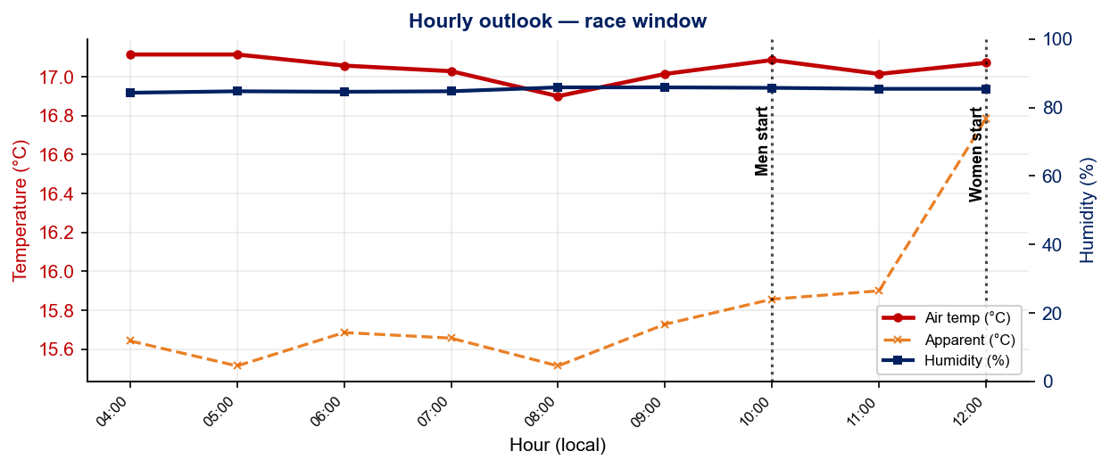
Race-Day Weather Outlook
Quiberon
2026-06-20 • Historical climatology — same calendar day, 7-year mean
Men start — 10:00
Temperature
Apparent / Heat
Humidity
17.1 °C
16.2 °C
86%
Wind
UV peak
Heat Stress
18.4 km/h
—
LOW
Women start — 12:00
Temperature
Apparent / Heat
Humidity
17.1 °C
16.8 °C
85%
Wind
UV peak
Heat Stress
17.3 km/h
—
LOW
Hydration & Cooling Cues
• Cool to mild outlook
• Notable wind (21 km/h) — drafting protection matters on exposed coastal bike sections; sight more frequently in chop
Data source: Open-Meteo. Forecast will replace climatology once race day is within 16 days. Historical Race Conditions slide shows what actually happened in prior years.

Slide 8
Travel & Arrival Load
Denver, CO → Quiberon race week
Core travel read
There are no direct Denver → Nantes flights. The cleanest athlete route is a one-stop itinerary through CDG, Dublin, Amsterdam, or another European hub into Nantes, then use the LOC/Nirvana scheduled shuttle to Quiberon. Many flight options include an overnight long-haul travel as a part of the leg. Minimize the 8h time zone shift by shifting daily schedule earlier before travel.
Primary route
DEN → NTE
1 stop likely
Flight time
~12h
Plus layover
Time zones
+8h
France ahead of Denver
Airport Transfer
NTE → Quiberon
LOC Scheduled Transfer
Transfer Distance
~2 hours
Host Hotel / Official Accommodation Read
• Official accommodation is 3 hotels: Sofitel Quiberon Thalassa Sea & Spa, Mercure Quiberon Hotel, and ENV-I2N.
• Sofitel = premium recovery/wellness choice, oceanfront thalassotherapy setting.
• Mercure = practical team option: renovated rooms, close to beach/thalasso area, free Wi‑Fi, bike storage in package.
• ENV-I2N = budget-oriented accommodation within a short ride/cycle to the event site.
Food / Grocery Options Near Hotel + Venue
• Best stock-up target: Super U Quiberon (116 Rue du Port de Pêche) for groceries, water, snacks, and room food.
• Quick basics: town-center bakeries, small markets, pharmacies, and convenience food around Quiberon centre / beach area.
• Restaurant read: seafood/crêperie-heavy resort town; plan simple athlete meals if avoiding rich sauces or unfamiliar seafood.
• Logistics note: peninsula access is constrained by one road/rail link. Potential for heavy traffic if coming from outside town center

Slide 9
Environmental Risk Profile
Quiberon
HEALTH & WATER QUALITY RISK FACTORS
• Water Quality: No Risk. Athlete guide sample values are safely inside WT reference limits: E.coli <15 / 46 / <15 per 100ml, Enterococci <15 at all points, pH 6.0–6.3, blue algae <0.5 μg/l.
• Athlete Health / GI Risk: No Risk. No Quiberon WTCS race-history. Primary health variable is cold-water / Atlantic exposure rather than documented GI illness.
• Water Temperature: Mid-June Atlantic range listed at 14.9–19.3°C; latest guide sample shows ~19.5°C. Likely wetsuit-legal.
• Heat / Humidity: Low heat risk. Forecast is mild with high around 22°C; humidity may be elevated, but temperature is less of a factor than the potential for winds along the coasts.
Weather and AQ data: Open-Meteo historical archive (archive-api.open-meteo.com). EU AQI: Good ≤20, Fair ≤40, Moderate ≤60, Poor ≤80, Very Poor >80.

Slide 10
Who to Watch — Quiberon Race Week
ELITE MEN
ELITE WOMEN
Top 3 Ranked on Startlist
Top 3 Ranked on Startlist
Rank | Athlete | Points
1 | Miguel Hidalgo | 6,703
3 | Vasco Vilaca | 6,164
4 | Henry Graf | 5,679
Rank | Athlete | Points
2 | Lisa Tertsch | 6,800
3 | Jeanne Lehair | 6,189
4 | Leonie Periault | 6,170
Returning Podium Athletes on Startlist
Returning Podium Athletes on Startlist
No prior race history at this venue.
No prior race history at this venue.
Rankings = current World Triathlon rankings snapshot; startlist intersect uses program_entries when available.

